Slide 1
SHWN_AXLL (AXLE LOGISTICS LLC.)
Always key the following, visible in the invoice separator sheet:
Batch ID (68) BAT ID (69) Value/No
Client Code (68) CL CODE (69) SHWN
Scac Code (68) SCAC CODE (69) AXLL

Slide 2
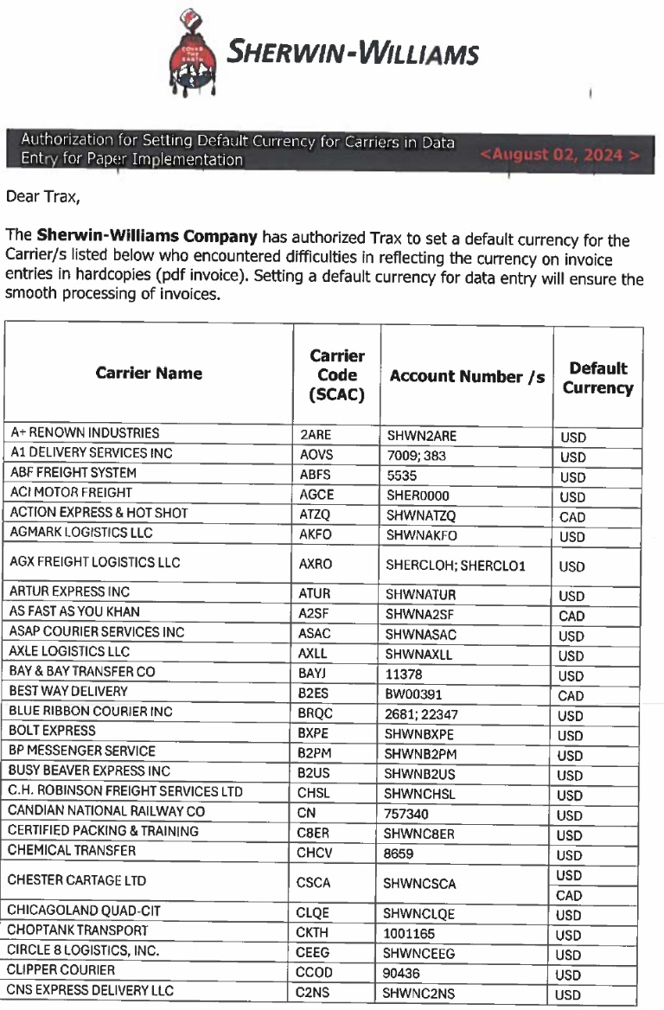
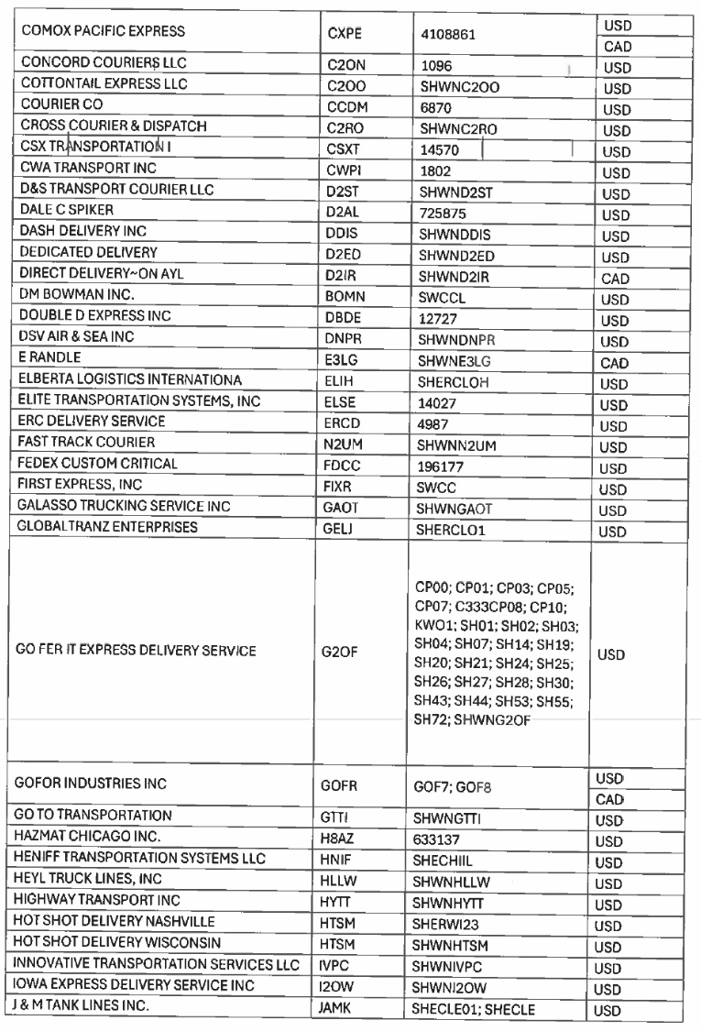
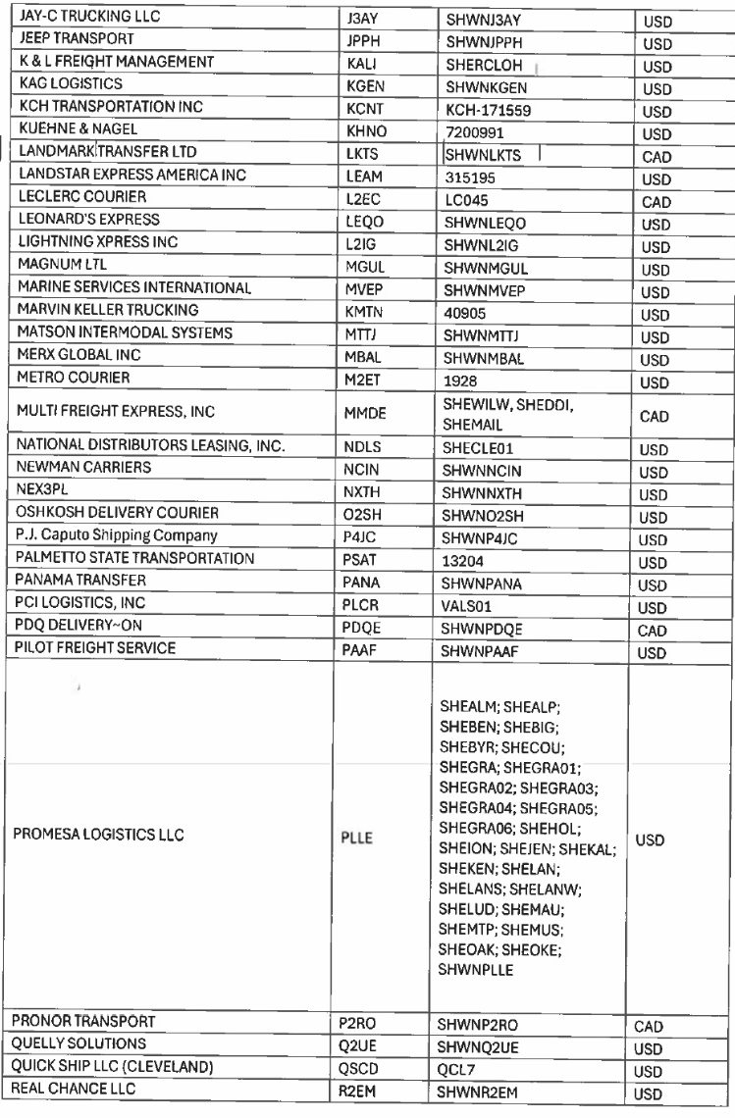
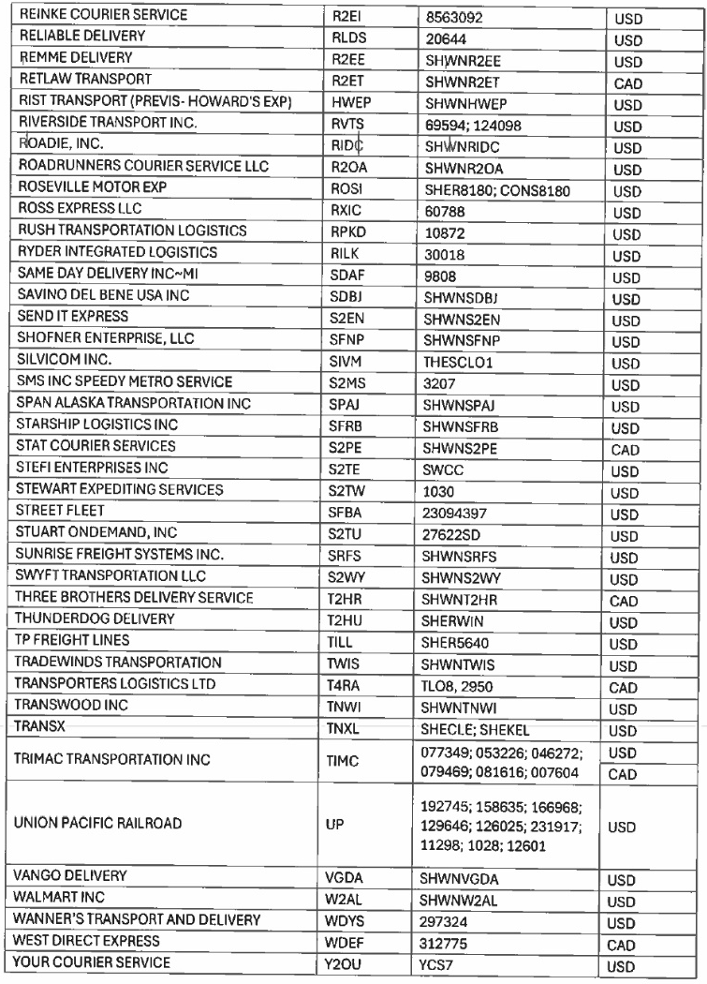
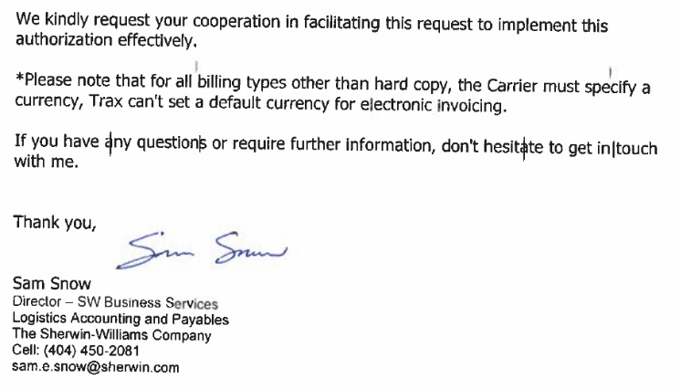

Slide 3
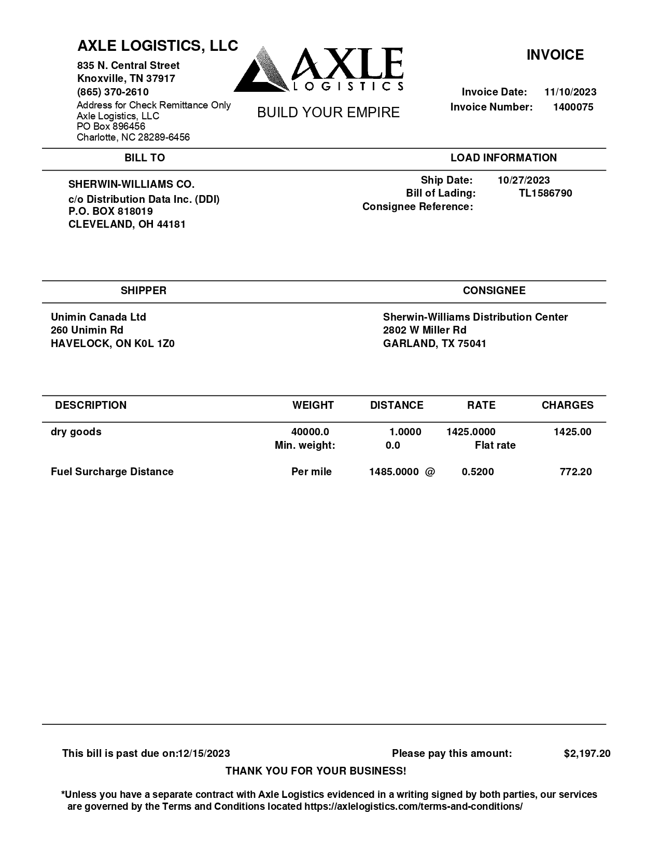
01
10
03
61
02
01 REMIT TO
02 BILL TO
03 INV KEY
09 CURR
10 DATE
11 DUE
27 SHIPPER INV
30 CONSIGNEE INV
42/43 ACTUAL WT/FNCL WT
48 DISTANCE
49 UOM
61 PICK UP
68a BOL
72 LINE ITEM DESCRIPTION
74 LINE ITEM QTY Q
75 LINE ITEM RATE
77 LINE ITEM RTUNT
85 LINE ITEM AMOUNT
08/14 INV AMT/FB AMT
68a
27
30
72
42/43
74
75
77
85
49
48
11
08/14
NOTE:
Please use “USD” as 09 CURRENCY Authorization letter for using default currency is in slide 2.
09

Slide 4
For Verification Table
 | NAME | DATE
DI-64399 | PHILLIP L. RAMISCAL | 9/13/2024

